Slide 1
Jane Austen Generator
By Edith Johnston

Slide 2


What I Made

Slide 3
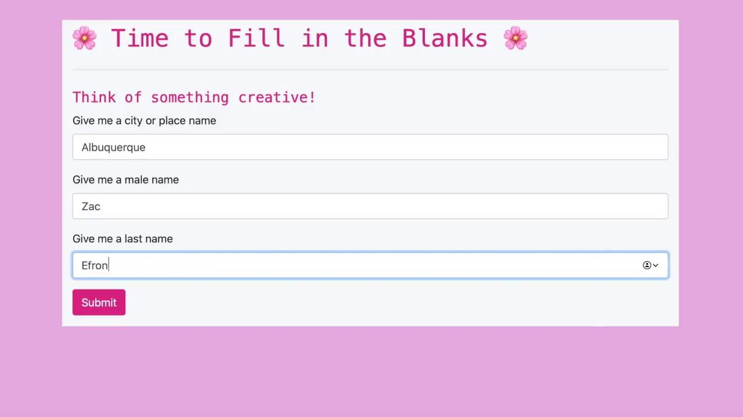

Slide 4

Proper Noun Handling
Types of Proper Nouns:
Place names
Boat names
Authors
Literature
Countries
Male, female and last names
And more!

Slide 5
Proper Noun Handling
Replaced in Text By Keys:
Place names → -PLC-
Boat names → -BTS-
Authors → -AUT-
Literature → -LTR-
Countries → -CNT-
Tools used:
python and regex

Slide 6

Text Generation
Two Methods
Markov Chaining
Prefix of 3 words
Artificial paragraph start and end tokens
Generate more natural paragraphs

Slide 7
Text Generation
Two Methods
Neural Net Model
Using embedding and Bidirectional LSTMs
Steep learning curve for model
Tools used:
TensorFlow, FastText, Word2Vec,
Gensim, NLTK, Google Colab

Slide 8

Text Generation
Two Methods
Neural Net Sample Output
dear determined and shall disguise subject dejection honour it disclaimed -LAST NAME- much his as a expressed accidental the he -MALE NAME- .
Markov Sample Output
"Yes; and they have so many pretty ways. They will come and stand by my chair, and say, 'Grandpapa, can you give me your opinion."

Slide 9



Future Work
More Authors with Distinct Styles
Improve Neural Net Model
Deploy the app

Slide 10

Thank you for your time
By Edith Johnston
LinkedIn: https://www.linkedin.com/in/edith-johnston/
Github: https://github.com/edithalice

Slide 11


Appendix

Slide 12
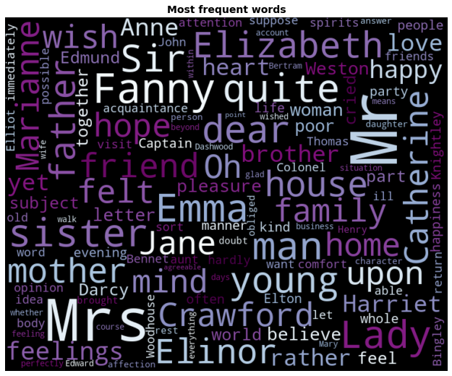
Data
Total Proper Nouns: 804
Number of these
that appear less
than 5 times: 480

Slide 13
Embedding Layer
Neural Net Structure
Bidirectional LSTM Layer
Backwards LSTM Layer
Two Dense Layers
100 neurons
100 neurons each direction
200 neurons
Final accuracy after approx 400 epochs: 0.4924
The first with 150 neurons and
the second with neurons of vocab size

Slide 14

Proper Noun Types
Languages
Months
Nationalities
Weekdays
Holidays
Bodies of water
Newspapers
Place names
Boat names
Authors
Literature
Countries
Male names
Female names
Last names

Slide 15


